Slide 1
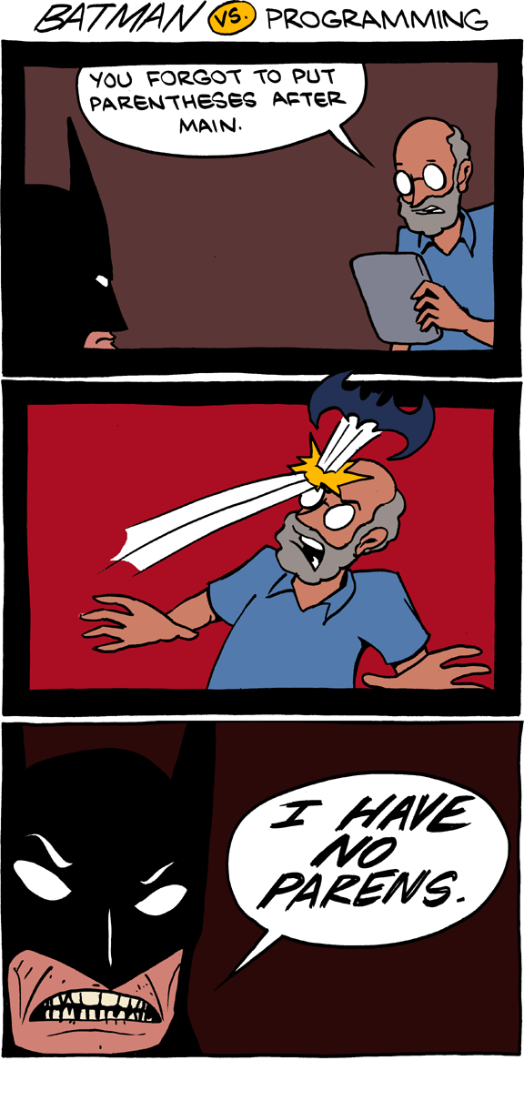
Lecture 20 - More Scheme
Chris Allsman
Notes:
https://www.smbc-comics.com/comic/2012-01-13

Slide 2

Lis(t) P(rocessing)

Slide 3
Scheme List Definition
A Scheme list is either:
nil
Composed of a first element (car) and the rest (cdr) of the Scheme list
Value of car is the number 1
1
2
3
List terminated with nil
car
cdr
car
cdr
car
cdr
cdr contains a pointer to a linked list

Slide 4
Creating Scheme Lists
Demo
1
2
3
car
cdr
car
cdr
car
cdr
(cons 1 __________________________________)
(cons 1 (cons 2 _________________________))
(cons 1 (cons 2 (cons 3 nil))

Slide 5
Scheme Lists vs. Linked Lists
Scheme Lists:
(cons a b)
(car lst)
(cdr lst)
nil
(1 (2 3))
Linked Lists:
Link(a, b)
lst.first
lst.rest
Link.empty
<1 <2 3>>

Slide 6
Checking Equivalence
Demo
(equal? e1 e2) checks if e1 and e2 evaluate to equivalent values
Like == in Python
(null? expr) is like (equal? expr nil)
(eq? e1 e2) checks if e1 and e2 evaluate to identical values
Like is in Python
Only matters for lists
(= e1 e2) only works for numbers

Slide 7
List Constructor
Demo
If we know each element we want to put in a list, we can use the list constructor
The list constructor takes in any number of elements and puts each element as a single element in a list
scm> (list 1 2 3)
(1 2 3)
scm> (list 0 (list 1 2 3))
(0 (1 2 3))
1
2
3
1
2
3
0

Slide 8
Quoting
Demo
The quote special form takes in a single argument and returns an unevaluated version of the argument
Quoting a symbol gives a symbol back, that symbol can mean something to scheme!
Quoting the representation of a list gives a list
scm> ‘(a b c)
(a b c)
scm> ‘(0 (1 2 3))
(0 (1 2 3))
1
2
3
a
b
c
0

Slide 9
Example - Add To End
Given a scheme list, lst, and an element, x, add x to the end of lst
(define (add-to-end lst x)
(if (equal? lst nil)
(cons x nil)
(cons (car lst) (add-to-end (cdr lst) x))))
scm> (add-to-end nil 1)
(1)
scm> (add-to-end '(1 2) 3)
(1 2 3)
scm> (add-to-end '(1 2 3) '(4))
(1 2 3 (4))

Slide 10
Using List Constructors

Slide 11
3 Levels Of Scheme Lists
Constructor
cons, list, quote
(cons (cons 1 nil) (cons 2 nil)
(list (list 1) 2)
‘((1) 2)
Use
Box and pointer diagrams - what’s the car and cdr?
Quoting the representation is a list constructor!
1
Representation
How is the list displayed?
2
((1) 2)

Slide 12
When to use each constructor
cons:
When you want to add an element on to the start of a list
Ex: add an element to the start of the list returned by a recursive call
list:
When you have multiple elements you want to put into a list all at once
Ex: want to create a two element list containing x and y
quote:
When you know the exact structure of the list and the values it contains
Ex: create a list to pass in as an argument in an interactive session
Notes:
Watch out for:
Passing in a list to the list constructor creates nesting
Quote won’t evaluate the values it contains

Slide 13
Break/Q&A

Slide 14
Tail Recursion

Slide 15
Recursion Versus Iteration in Python
Demo
Multiplication Operations? | Frames?
n | n
n | 1
def rfactorial(n): if n == 0: return 1 else: return n * rfactorial(n - 1)
def ifactorial(n): total = 1 while n > 0: total *= n n -= 1 return total

Slide 16

Back In Line
Here’s how we calculated your position in line from the recursion lecture
If nobody’s in front of you, you’re first in line
Otherwise, ask the person in front of you their position and add one
Issue: Everyone needs to remember that they’re supposed to add 1 to the position of the person in front of them

Slide 17

Line Example, Revised
Here’s one potential optimization:
In addition to passing along the message, pass along a piece of paper
When a new person gets the paper, add a tally mark
When the paper gets to the front, send it to the original person
Seventh!
|
||
|||
||||
|||||
|||||
|
|||||
||

Slide 18
Tail Recursion
An expression in a tail context is evaluated as the last step the function call
That means nothing is evaluated/applied after it is evaluated
Function calls in a tail context are called tail calls
If all recursive calls are in tail contexts, we say that function is tail recursive
If a language supports tail call optimization, a tail recursive function will only ever open a constant number of frames

Slide 19
Identifying Tail Contexts
An expression is in a tail context only if it is the last thing evaluated in every possible scenario, regardless of the other values
For each of the following expressions, which expressions (expr1, expr2, expr3) are in a tail context?
(and expr1 expr2 expr3)
(if expr1 expr2 expr3)
(+ expr1 expr2)
((lambda (expr1) expr1) expr2)

Slide 20
Recursive frames
f1: fact
n: 4
rv: .
24
f2: fact
n: 3
rv: .
We need to keep these frames open because the last step in the function is to multiply n with the result of the recursive call.
(define (fact n)
(if (= n 0)
1
(* n (fact (- n 1)))))
6
f3: fact
n: 2
rv: .
2
Consider a call to fact(4)
f4: fact
n: 1
rv: .
1
f5: fact
n: 0
rv: 1

Slide 21

Tail calls
Demo
f1: fact-tail
n: 4
result: 1
rv: whatever (fact-tail (- 4 1)
(* 4 1)) returns
(define (fact n)
(define (fact-tail n result)
(if (<= n 1)
result
(fact-tail (- n 1) (* n result))))
(fact-tail n 1))
fact(4)
f2: fact-tail
n: 3
result: 4
rv: whatever (fact-tail 2 12) returns.
f3: fact-tail
n: 2
result: 12
rv: whatever (fact-tail 1 24) returns.
f4: fact-tail
n: 1
result: 24
rv: 24
Number of frames the same regardless of input size!

Slide 22
Writing Tail Recursive Functions (Method I)
Identify recursive calls that are not in a tail context. Tail contexts are:
The last body subexpression in a lambda (a function)
The consequent and alternative in a tail context if
All non-predicate sub-expressions in a tail context cond
The last sub-expression in a tail context and, or, begin, or let
2) Create a helper function with arguments to accumulate the computation that prevents it from being tail recursive

Slide 23
Example: Length of Linked List
Demo
Goal: Write a function that takes in a list and returns the length of the list. Make sure it is tail recursive.
(define (length lst)
(if (null? lst)
0
(+ 1 (length (cdr lst)))))
(define (length-tail lst)
(define (helper lst s)
(if (null? lst)
s
(helper (cdr lst) (+ s 1))))
(helper lst 0))
scm> (length ‘())
0
scm> (length ‘(1 2 (3 4))
3

Slide 24
Writing Tail Recursive Functions (Method II - If Time)
def fact(n):
total = 1
while n > 0:
total, n = total * n, n - 1
return total
(define (fact-tail n)
(define (helper n total)
(if (= 0 n)
total
(helper (- n 1)
(* total n))))
(helper n 1))

